Slide 1


Department of Electronics and Communication Engineering
Musical Instrument Detection
Sanika Chougule USN:02FE22BEC080
Shraddha Shahapurkar USN:02FE22BEC091
Adarsh Kadalikar USN:02FE23BEC410
Tejas Khadpe USN:02FE23BEC412
Under the Guidance of
Prof : Vinayak Dalvi

Slide 2
Content
Sl No. | Content
1 | Introduction
2 | Problem Statement
3 | Literature Survey
4 | Signal Specifications
5 | Filters
6 | Block Diagram
7 | Results
8 | References

Slide 3
Introduction
A musical instrument recognition system plays a crucial role in modern audio processing and music analysis, addressing the need for precise identification of instruments in a wide range of applications. From automated music transcription to digital archiving and real-time music editing, this technology enables efficient and accurate classification of sounds. By extracting distinct features like frequency, timbre, and harmonics, it ensures seamless recognition, even in complex audio environments. This system not only enhances music production but also contributes to research, education, and preservation of musical heritage.

Slide 4
Problem Statement
Develop a music instrument recognition system that will analyze the input voice of the instrument with the help of its features and checks whether the instruments's voice is registered in the database or not .​

Slide 5
LiteratureSurvey
Sl.No | Paper Title | Objective | Methods/Techniques/ Algorithm used | Limitations /Disadvantages/Remarks
1. | Musical instrument recognition using cepstral coefficients and temporal features | To recognize musical instruments using cepstral coefficients. temporal features | FFT-based spectral features. Temporal feature extraction | Limited by environmental noise, needs high-quality recordings
2. | Musical instrument recognition using biologically inspired filtering of temporal dictionary atoms | To develop a biologically inspired filtering method for musical instrument recognition | Biologically inspired filtering of temporal dictionary atoms. Short-Time Fourier Transform (STFT) | Limited to specific instruments, does not handle polyphony well

Slide 6
3. | Hierarchical classification for instrument activity detection in orchestral music recordings | Develops a hierarchical classification for detecting instrument activity in orchestral music | Utilizes a hierarchical classification system with temporal and spectral features. including FFT and MFCC | Struggles with detecting overlapping instrument sounds in complex music
4. | Temporal integration for audio classification with application to musical instrument classification | To improve audio classification by applying temporal integration for instrument classification | Temporal integration, Machine learning-based classification | Sensitive to input signal quality and recording conditions

Slide 7
5. | A multiple-expert framework for instrument recognition | The study proposes a multiple-expert framework for improving instrument recognition accuracy | Fast Fourier Transform (FFT). Wavelet Transform and multiple-expert system combines various specialized classifiers to improve recognition accuracy | The system's complexity may lead to higher computational cost and longer processing times.
6. | Hierarchical classification for singing activity, gender, and type in complex music recordings | The paper focuses on classifying singing activity, gender, and type in complex music recordings | hierarchical classification methods to distinguish between different singing activities. Temporal and Spectral Feature Extraction | Limited by the complexity of classifying different genres and overlapping audio signals.

Slide 8
LiteratureSurvey
1. | Fast Fourier Transform and Its Applications | Introduce FFT and demonstrate its applications in DSP | Fast Fourier Transform (FFT) Discrete Fourier Transform (DFT) | Computationally intensive for large datasets real-time applications may require optimization
2. | A Faster Fast Fourier Transform | Develop a more efficient FFT algorithm | Optimized FFT Sparse FFT techniques | High performance depends on input sparsity limited to certain signal types

Slide 9
3. | The Fast Fourier Transform | Presenting both comprehensive and largely original proof for the fft algorithm | Fast Fourier Transform Fast convolution algorithm | Implementation complexity Memory requirement
4. | Application of the FFT | Provide an overview of the main issues with Fourier analysis and fft using semi-discrete Fourier transform and differential matrices | Differential matrices Semi –discrete Fourier transform | Limited scope of application Complexity in differential matrices

Slide 10
Sl.No | Paper Title | Objective | Methods/Techniques/ Algorithm used | Limitations /Disadvantages/Remarks
1. | Hierarchical Filtering Method for Content-based Music Retrieval via Acoustic Input’ | Develop a query-by-humming system for music retrieval | Fourier analysis and dynamic programming for melody matching | Limited by environmental noise, needs high-quality recordings
2. | Analysis and Development of First Order High Pass Active Filter | Design and analyze a first-order high-pass active filter to attenuate low frequencies. | Transfer function analysis, op-amp-based circuit, simulation using MATLAB/PSPICE. | Limited to low-order filtering, requires power supply, dependent on op-amp quality.
3. | Importance of High Order High Pass and Low Pass Filters | Design and analyze high-pass and low-pass filters for efficient signal processing. | Transfer function analysis, circuit design with op-amps, MATLAB/PSPICE simulations. | Limited order sharpness, requires external power, affected by op-amp non-idealities.

Slide 11
Filters:
High-pass and low-pass filters are essential tools in audio signal processing, including music instrument detection. They help isolate specific frequency ranges that are characteristic of particular instruments
Role of High-Pass and Low-Pass Filters
High-Pass Filter
Allows high frequencies to pass and attenuates frequencies below a specified cutoff.
Instruments like flutes, violins, and guitars produce sound predominantly in higher frequency ranges.A high-pass filter can be applied to remove low-frequency noise or interference (e.g., background hum, bass sounds) before analyzing the spectral features.In this code, you could add a high-pass filter to preprocess audioData before computing the FFT to improve the detection of high-frequency instruments.
Low-Pass Filter
Allows low frequencies to pass and attenuates frequencies above a specified cutoff.
Instruments like bass guitar, table , or kick drums produce sound in the lower frequency range.A low-pass filter can help suppress higher-frequency harmonics or noise, making it easier to identify the fundamental frequencies of these instruments . Adding a low-pass filter in this code could help refine the detection of low-frequency instruments.

Slide 12
Signal Specifications
1. Audio Format
Supported Formats: WAV
Bit Depth: 16-bit or higher
Sampling Rate: 16 kHz
2. Frequency Range
Low Frequencies: 20 Hz to 200 Hz (eg guitar, table )
Mid Frequencies: 200 Hz to 2 kHz (eg piano, guitar, violin).
High Frequencies: 2 kHz to 16 kHz (eg flute).
3.Signal Duration
10-20seconds
4 Filtering Parameters
Low-Pass Filter:
  Passband Frequency: Below 1 kHz.
  Stopband Frequency: 1.2 kHz.
High-Pass Filter:
  Passband Frequency: Above 200 Hz.
  Stopband Frequency: Below 100 Hz.

Slide 13
Block Diagram

Slide 14
Results
A collection of .wav audio files was prepared, each representing a specific instrument (e.g., Piano, Guitar, Tabla).
The program was tested on these files to identify the instrument using its peak frequency detection logic.
The results were compared to the known instrument labels to evaluate accuracy.

Slide 15
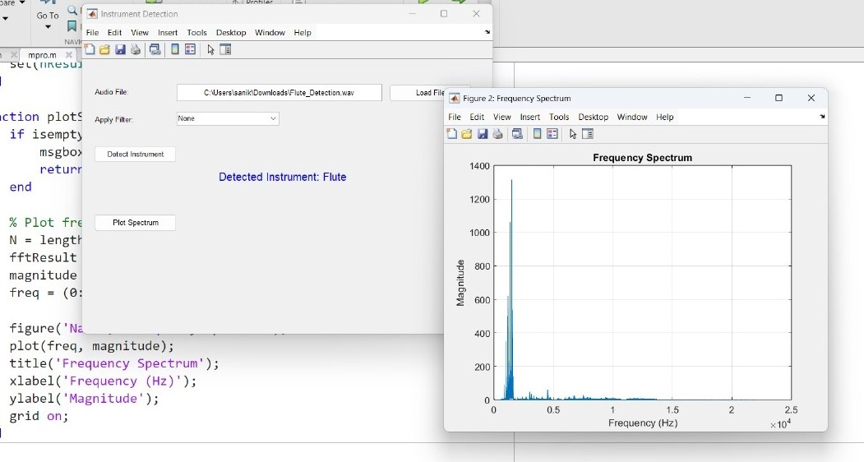
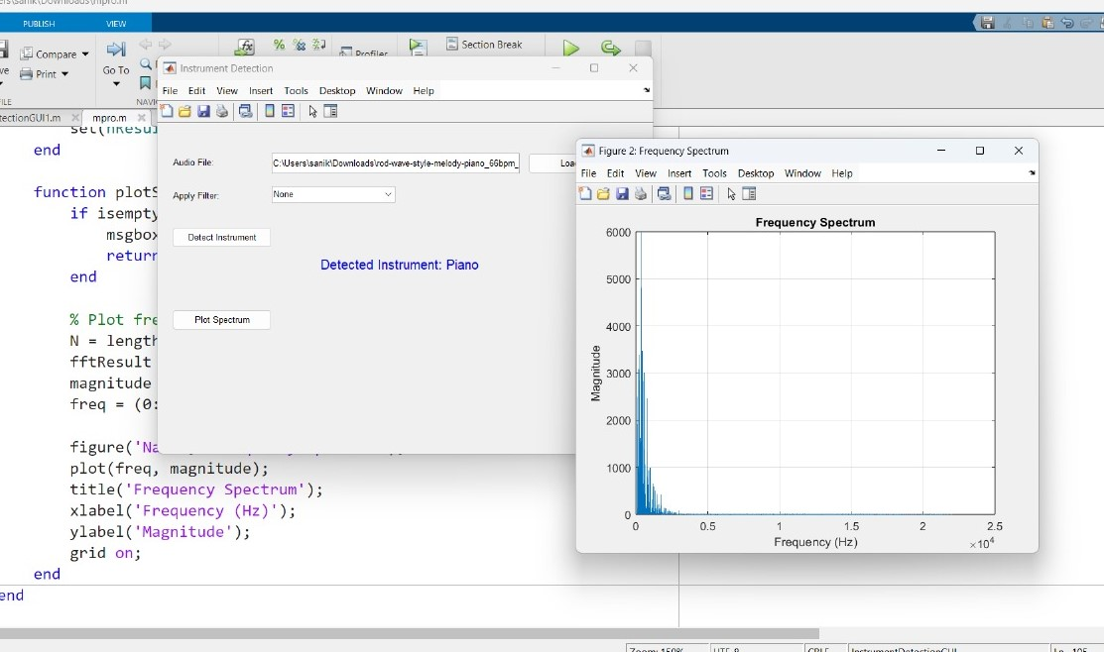
Sample Results:

Slide 16
Conclusion
In this project, we developed an instrument detection system using Digital Signal Processing (DSP) techniques to analyze audio files and identify musical instruments. The system relies on extracting key features such as dominant frequencies, spectral content, and harmonic structures from the audio signal. Through these features, instruments like piano, guitar, tabla, and flute were successfully detected.

Slide 17
References
[1] M. Krause and M. Müller, “Hierarchical classification for singing activity, gender, and type in complex music recordings,” in Proc. IEEE Int. Conf. Acoust. Speech Signal Process., 2022, pp. 406–410
.[2] A. J. Eronen and A. P. Klapuri, “Musical instrument recognition using cepstral coefficients and temporal features,” in Proc. IEEE Int. Conf. Acoust. Speech Signal Process., Istanbul, Turkey, 2000, pp. II753–II756.
[3] M. Grasis, J. Abeßer, C. Dittmar, and H. M. Lukashevich, “A multiple-expert framework for instrument recognition,” in Proc. Int. Symp. Sound Music Motion, Marseille, France, 2014, pp. 619–634.
[4] S. K. Tjoa and K. J. R. Liu, “Musical instrument recognition using biologically inspired filtering of temporal dictionary atoms,” in Proc. Int. Soc. Music Inf. Retrieval Conf., 2010, pp. 435–440.
[5] C. Joder, S. Essid, and G. Richard, “Temporal integration for audio classification with application to musical instrument classification,” IEEE Trans. Audio, Speech, Lang. Process., vol. 17, no. 1, pp. 174–186, Jan. 2009.
[6] M. Krause, M. Müller, and M. V. W. Gärtner, “Hierarchical classification for instrument activity detection in orchestral music recordings,” in Proc. IEEE Int. Conf. Acoust. Speech Signal Process., 2023, pp. 1–5.
[7] E. O. Brigham, The Fast Fourier Transform and Its Applications, Englewood Cliffs, NJ, USA: Prentice-Hall, 1988.
[8] H. Hassanieh, P. Indyk, D. Katabi, and E. Price, “A Faster Fast Fourier Transform,” in Proc. ACM SIGACT Symp. Theory Comput., 2012, pp. 563–578.

